Slide 1

Early Forecastinging of low birth weight cases using Ensemble Learning techniques
by
K. Samyuktha
Roll No. 204G1A0592
N. Ranga Dhamini
Roll No. 204G1A0579
S. Vandana Bai
Roll No. 204G1A05B9
B. Vishnu
Roll No. 204G1A05C3
Under the guidance of
Mrs. M. Soumya M.Tech, (Ph.D)
Assistant Professor
Assistant Professor
Department of Computer Science and Engineering
Srinivasa Ramanujan Institute of Technology
Autonomous
Rotarypuram Village, B K Samudram Mandal, Ananthapuramu – 515701.
2023-2024

Slide 2
Comments
What is the scope of your project
How can you implement of dataset
Methods of accuracy measurements
why you choose svc
No of epochs to be considered
Paper should be improved

Slide 3

Contents
Abstract
Introduction
Literature Survey
Existing System
Proposed System
Planning
Design
Implementation
Research Paper
References

Slide 4
Abstract
Low Birth weight acts as an indicator of sickness in newborn babies. LBW is closely associated with infant mortality as well as various health outcomes later in life. Machine learning techniques are used to gain useful information from health indicators of pregnant women for early detection of potential low birth weight cases. Low birth weight in infants leads to a range of health and developmental problems like respiratory distress syndrome and difficulties in temperature regulation.
Ensemble Learning techniques like Stacking are used for better performance. Maternal factors such as age, ethnicity, education, and medical history are included, along with prenatal factors such as the number of prenatal care visits, gestational age, maternal weight gain, and no of preterm etc. are used as attributes in dataset
Keywords: Low Birth weight (LBW), Ensemble Learning ,Infants birth ,Decision tree.

Slide 5
Introduction
World Health Organization Maternal Health and Safe Motherhood Programme-1992, Low Birth Weight. It is expected to rise at the rate of 12% every year.
Low birth weight is the term used to refer to babies born with a weight less than 2500gm Low birth weight (LBW) has been identified as a major public health problem around the world.
Numerous studies conducted worldwide show a high correlation between a mother's health and her baby's birth weight
This phenomenon is now of global concern in the view of serious short term and long term problems such as development disorders, neuro sensory outcomes, health outcomes including Type 2 diabetes, cerebral stroke, hypertension and various other disorders that LBW babies are prone to.
The ultimate goal is to create a practical and effective tool that can be integrated into existing healthcare systems to improve LBW risk assessment and maternal-infant care.

Slide 6
Literature survey
[1]. Kramer MS. Determinants of Low Birth Weight: methodological assessment and meta-analysis. Bull World Health Organ. 1987;Dharmik, R. C., Chavhan, S.Gotarkar, S. Pasoriya, A. (2022)
The paper is about determinants of low birth weight: methodological assessment and meta-analysis. In developed countries, the most important factor was cigarette smoking, followed by nutrition and pre-pregnancy weight. In developing countries the major determinants were nutrition, low pre-pregnancy weight, short maternal stature, and malaria.
Risk factors for low birth weight and intrauterine growth retardation in Santiago, Chile.
The cases were defined as live births < 2500 g. All cases and a random sample of controls were selected among 8,254 singleton births occurring at the El Salvador Hospital in the Eastern area of Santiago. These deliveries represented 50% of institutional deliveries in the area. Home deliveries (2%) and private hospital deliveries were not included in the study.

Slide 7
Literature survey
Eliyati N, Faruk A, Kresnawati ES, Arifieni I. Support vector machines for classification of low birth weight in Indonesia. J Phys Conf Ser. 2019; 1282:012010.
This paper is about support vector machine, used as reference to know how support vector is used in model generation and about different kernels and how they work.
Yash Khandelwal, “Ensemble Stacking for Machine Learning and Deep Learning”, 13 Aug, 2021.
This paper is a about what are ensemble learning and how they and how they differ from each. From the paper we learned about ensemble techniques and their types.

Slide 8
Existing System
In existing system, model used is Random Forest and Xgboost and Decision Tree to estimate whether the baby belongs to the Low Birth Weight or not belongs to the Low Birth. This model employs low accuracy and inaccurate results.
Disadvantage:
Low accuracy: The model's predictions do not align closely with the actual outcomes, resulting in a high rate of incorrect classifications and reduced trustworthiness.
Low reliability: The system lacks consistency in producing dependable results, making it unreliable for critical tasks or decision-making.

Slide 9
Proposed System
In the proposed system, we employ a sophisticated approach that leverages supervised machine learning algorithms, specifically Stacking Algorithms with combination of Support Vector Classifier (SVC) and XGBoost to enhance the prediction of Low Birth Weight (LBW) cases in early pregnancy.
The proposed system contains the following facilities over the present system:
1.High accuracy: The system delivers precise results, aligning closely with real-world outcomes, enhancing decision-making, and boosting confidence in its predictions.
2. Time-saving: It significantly reduces the time required for tasks or processes, increasing overall efficiency and productivity.
3. Low complexities: It features a straightforward, user-friendly design with minimal intricacies, enhancing usability and ease of implementation.

Slide 10
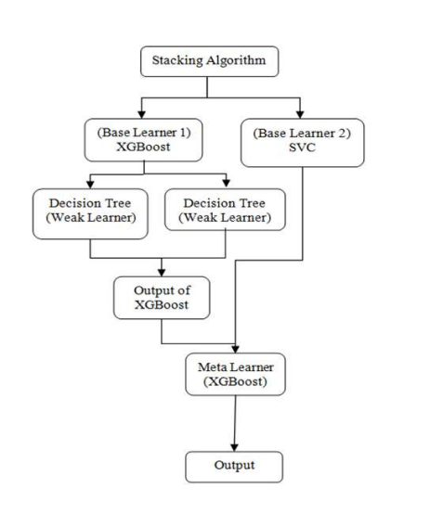
Proposed System
Fig 1: Working of stacking technique

Slide 11
Proposed System
The objectives of this proposed system are
Our main objective is to accurately predicts the likelihood of Low Birth Weight (LBW) using Machine Learning.
To Develop that we used the Ensemble Machine Learning model that is stacking algorithm which can accurately predicts the Low Birth Weight (LBW).
To Create a user-friendly web application that allows users to input information and by integrating with the trained ML model, provides early forecasts of LBW.
To Increase accuracy.
To reduce human intervention.
Easy maintenance and security of Data.

Slide 12
Planning
Functional Requirements
User need to create login id and password for the first time
User required to enter username and password to login.
Authentication of user whenever he/she logs into the system
User can choose to which algorithm to run.
User can also add the new data set to train the data.
To get accurate result ,user need to enter all values.

Slide 13
Planning
Requirements:
Hardware Requirements:
RAM : 4GB
Hard Disk : 128TB
Processor : I3 and above
Software Requirements:
IDE : Visual Studios
Programming Language : Python 3.8
Operating System : Windows7+
GUI : Flask
Libraries Used : Pandas, NumPy, Matplotlib, OS.

Slide 14
Planning
Methodology
This project uses Agile methodology. In that we use scrum agile methodology.
Scrum is characterized by cycles or stages of development, known as sprints.
It has four stages: Planning, Implementation, Testing and review.
Advantages:
This Methodology has ability to change and adapt with and satisfy the changing needs in short term.
Requires less documentation.

Slide 15
Planning
Our approach leverages supervised machine learning algorithms, specifically Stacking Algorithms combined with Support Vector Classifier (SVC) and XGBoost.
This comprehensive strategy aims to enhance the prediction accuracy of LBW cases in early pregnancy, ultimately contributing to improvements in neonatal healthcare and maternal well-being.
We provide a step-by-step overview of the implementation process:
i. Data Acquisition
ii. Preprocessing
iii. Model Implementation
iv. Prediction

Slide 16
Planning
System Modules:
1.Take Dataset
2.Store Dataset
3.Traning
4.Model Creation
i. XGBoost
ii. Decision tree
iii. SVC
iv. Stacking (proposed algorithm)
v. Random Forest
5.Generate Results

Slide 17
Planning
User Modules
1.Login
2.Load Dataset
3.View Dataset
4.Select Model
5.Prediction
6.Logout

Slide 18
Planning
Work Schedule
S.No | Development Stage | Duration
1. | Domain and Title | 1 week
2. | Literature Survey | 2 weeks
3. | Planning | 1 week
4. | Design | 1 week
5. | Requirements Gathering | 1 week
6. | Testing | 3 weeks
7. | Implementation | 4 weeks

Slide 19
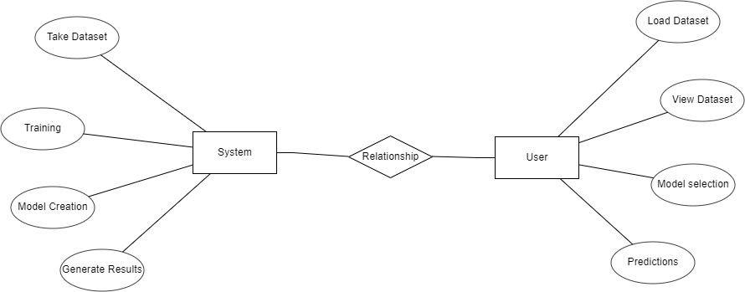
Design - ER Diagram
The ER diagram was created to help grasp the entire scenario. It was used to conceive the phenomena, actions, and interactions between numerous entities, as well as to arrive at the precise requirements in a complete manner.

Slide 20
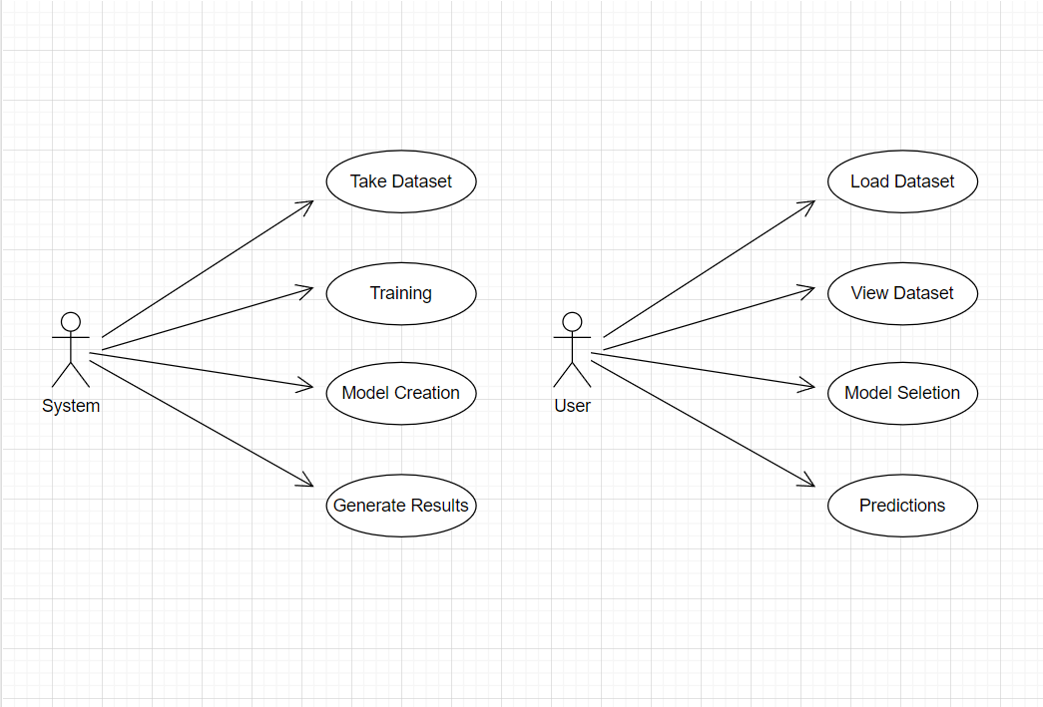
Design - Use Case Diagram

Slide 21
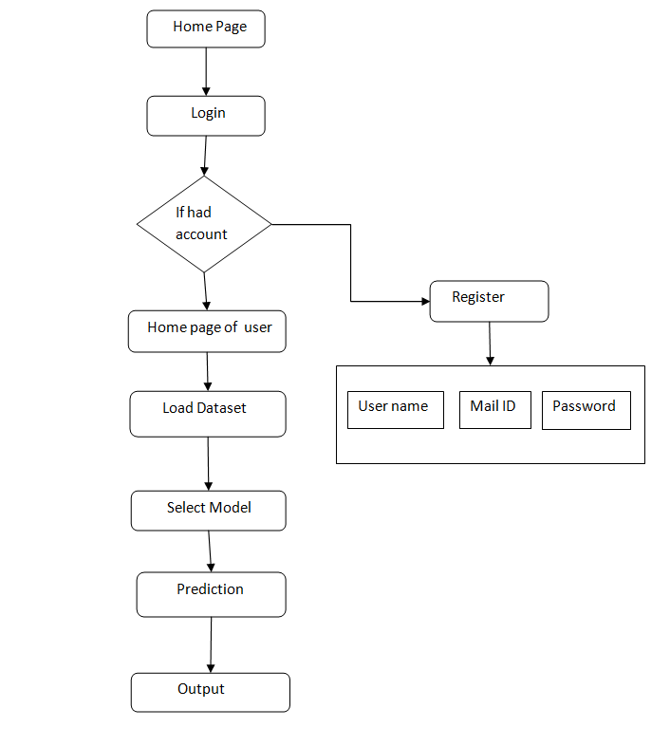
Design – Second Objective

Slide 22
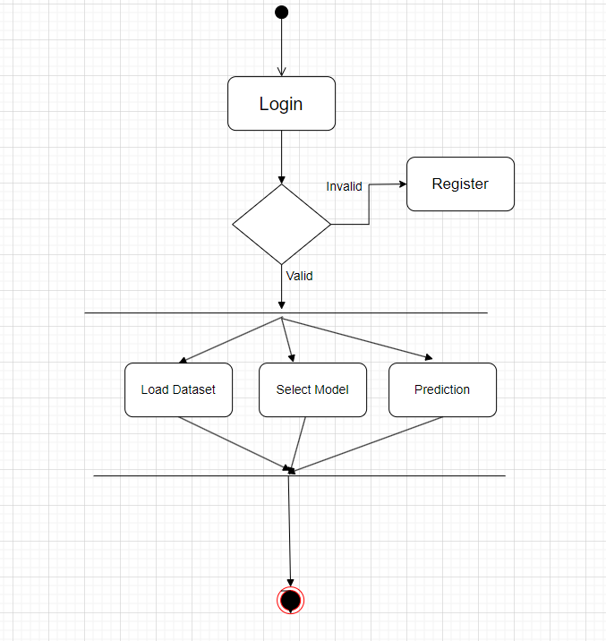
Design - Activity Diagram

Slide 23
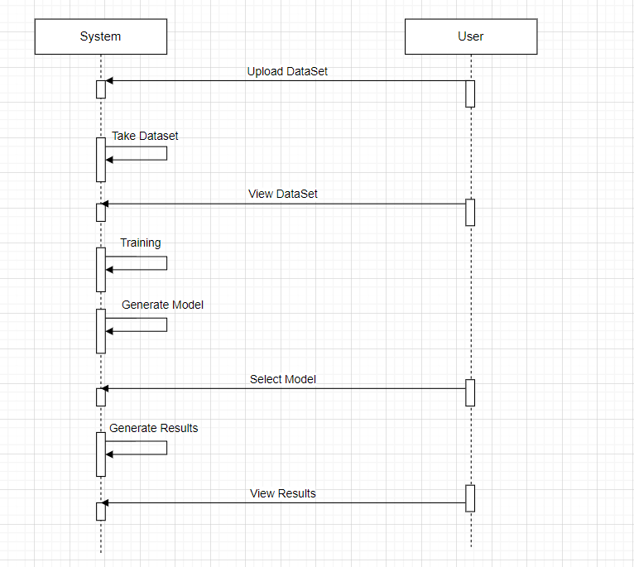
Design - Sequence Diagram

Slide 24
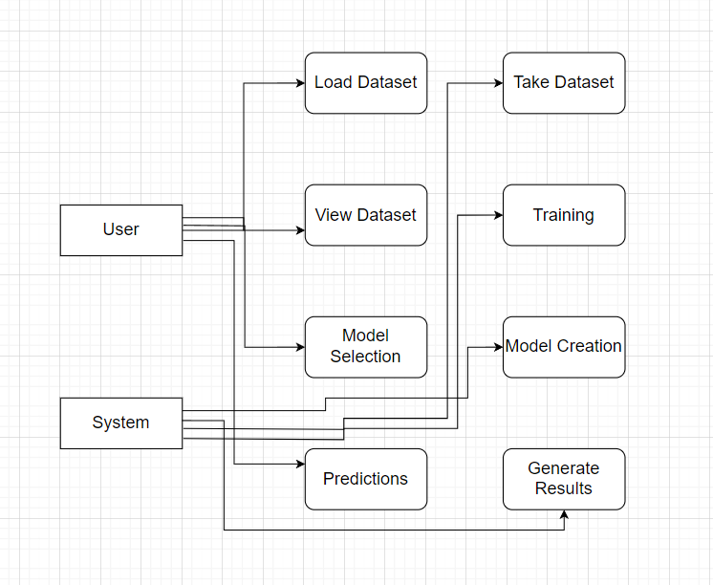
Design – Data Flow Diagram

Slide 25
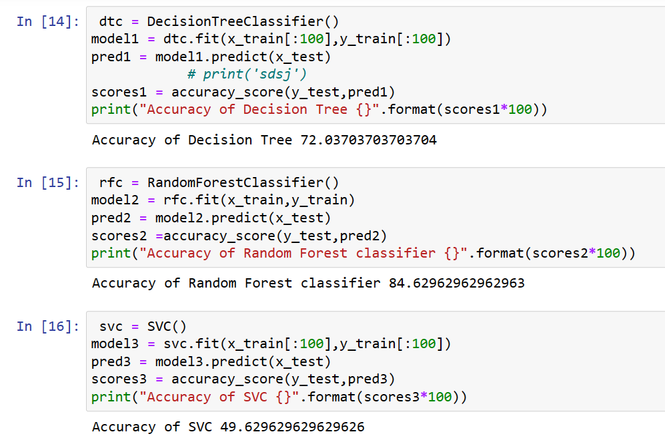
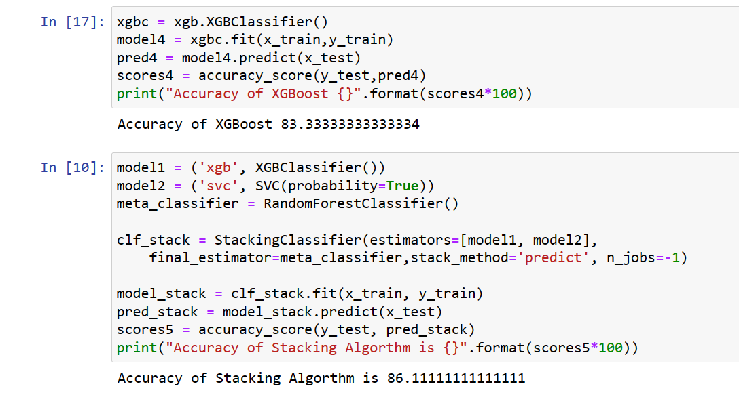
Implementation
Output for Accuracy of different algorithm:

Slide 26
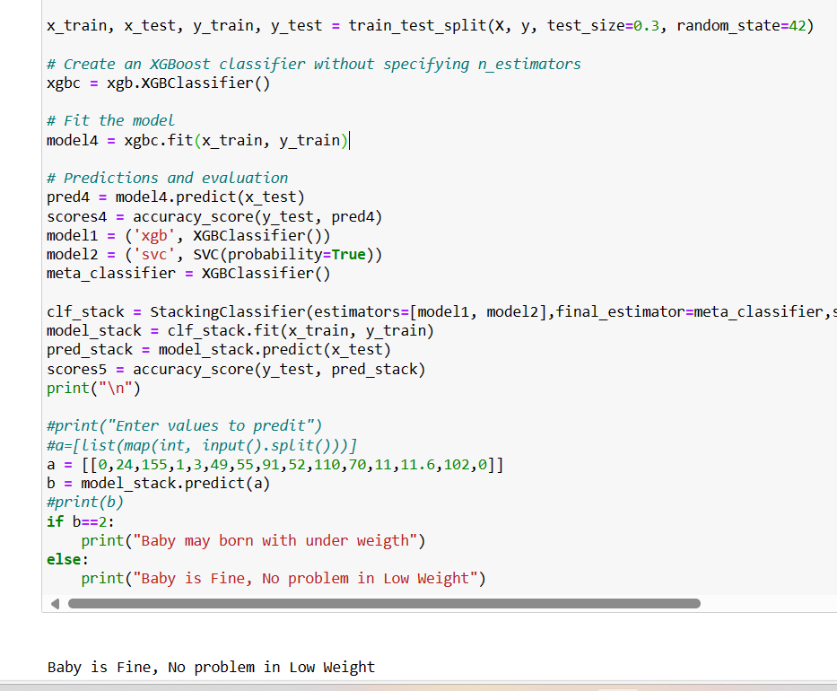
Implementation

Slide 27
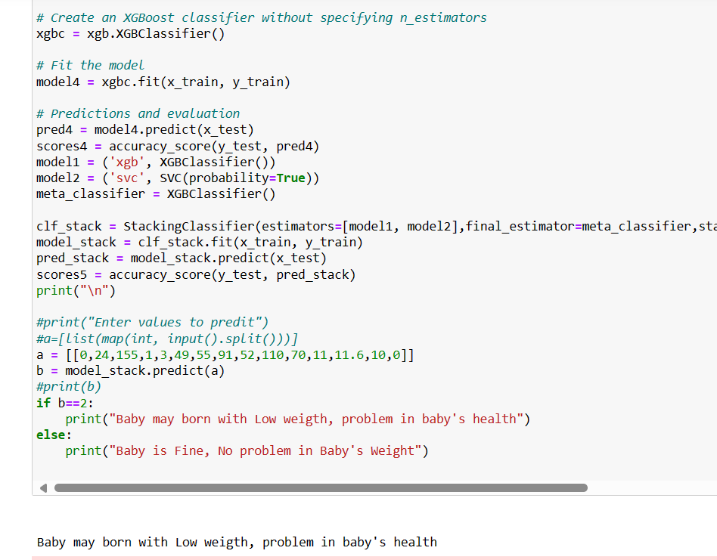
Implementation

Slide 28
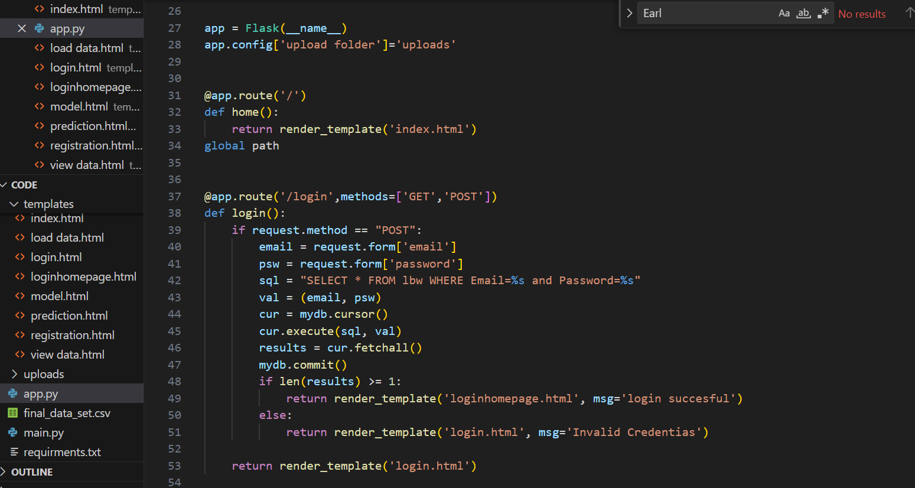
Implementation

Slide 29
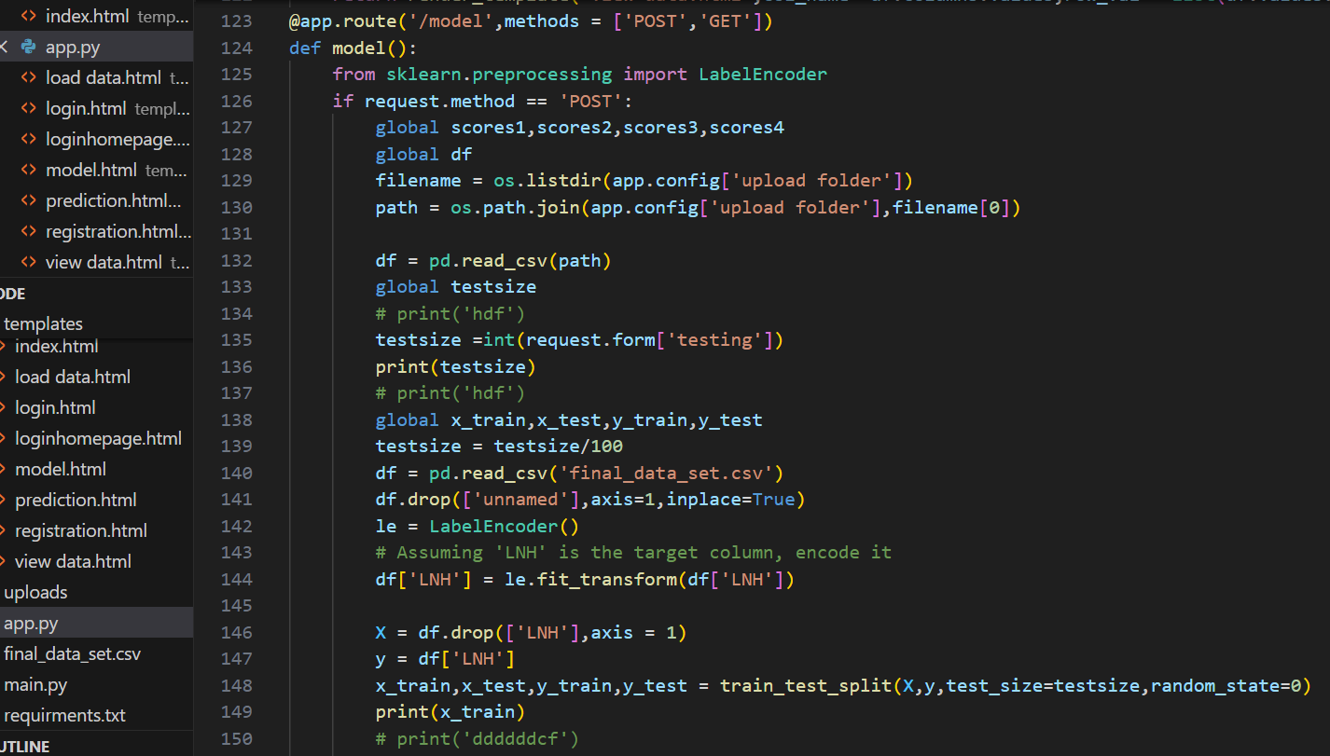
Implementation

Slide 30
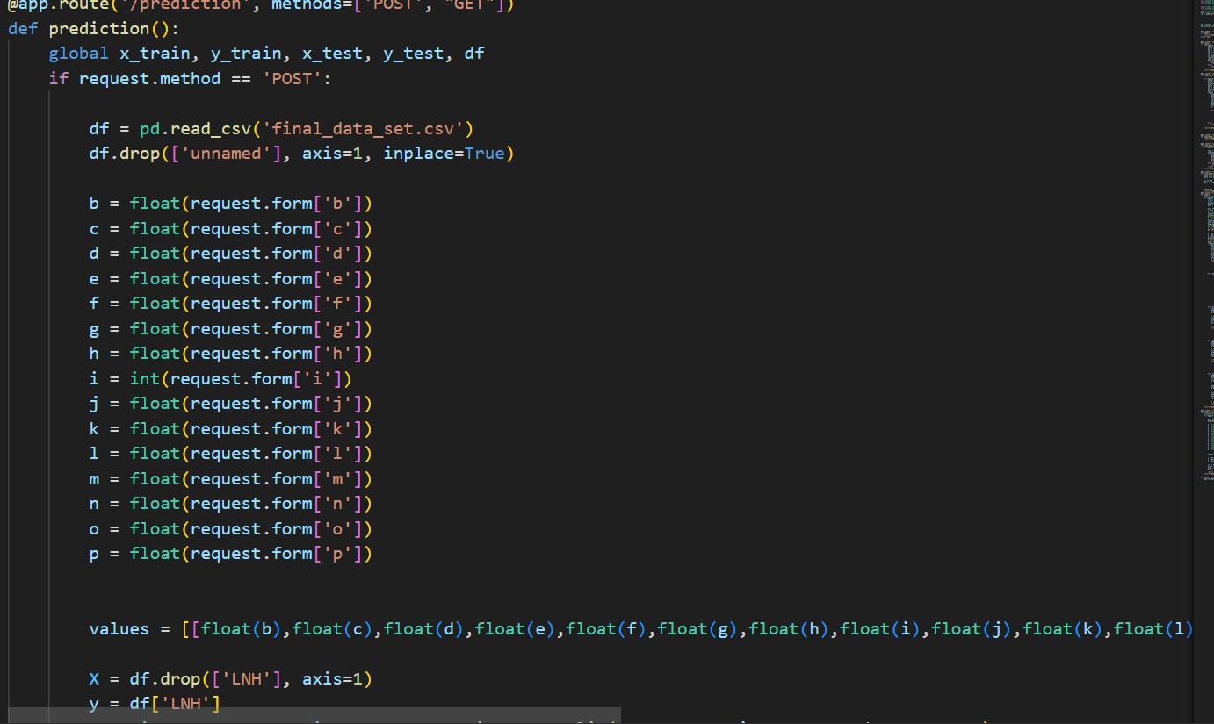
Implementation

Slide 31
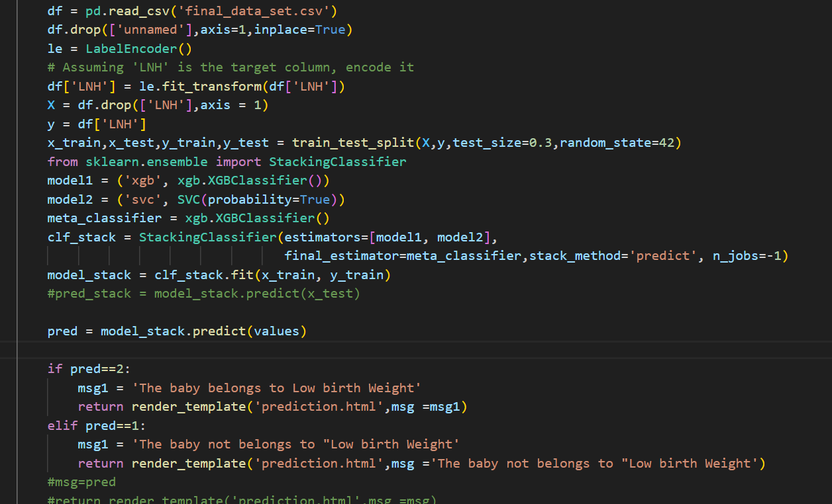
Implementation

Slide 32
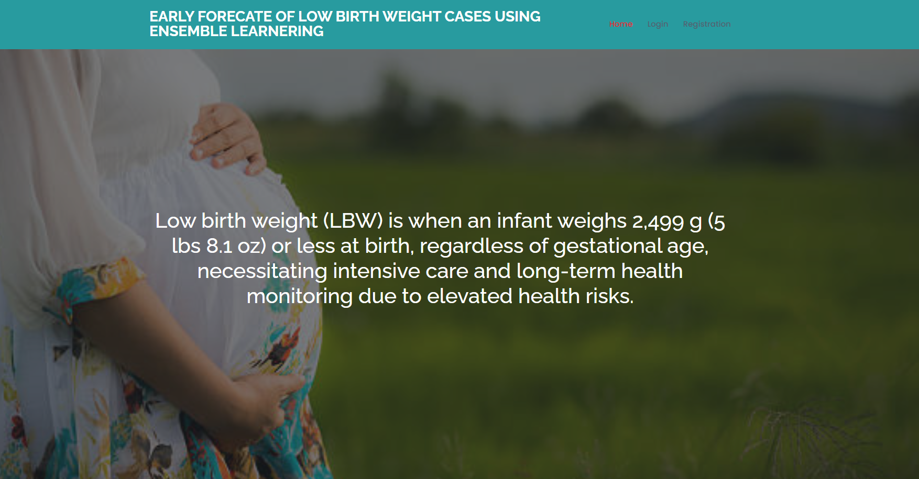
Results
Outputs:

Slide 33
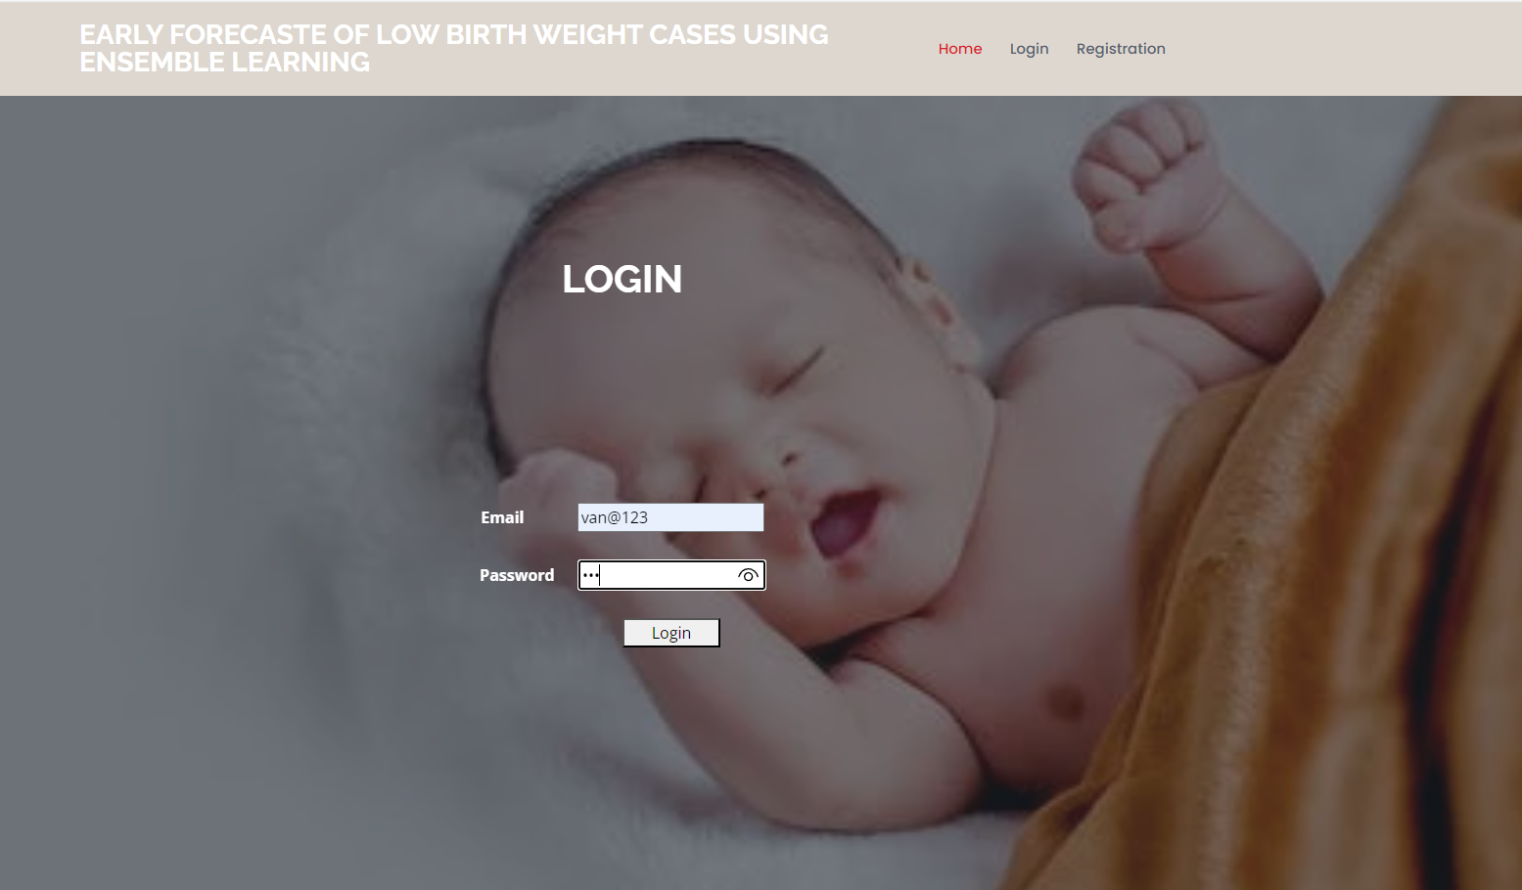
Results
Login page:

Slide 34
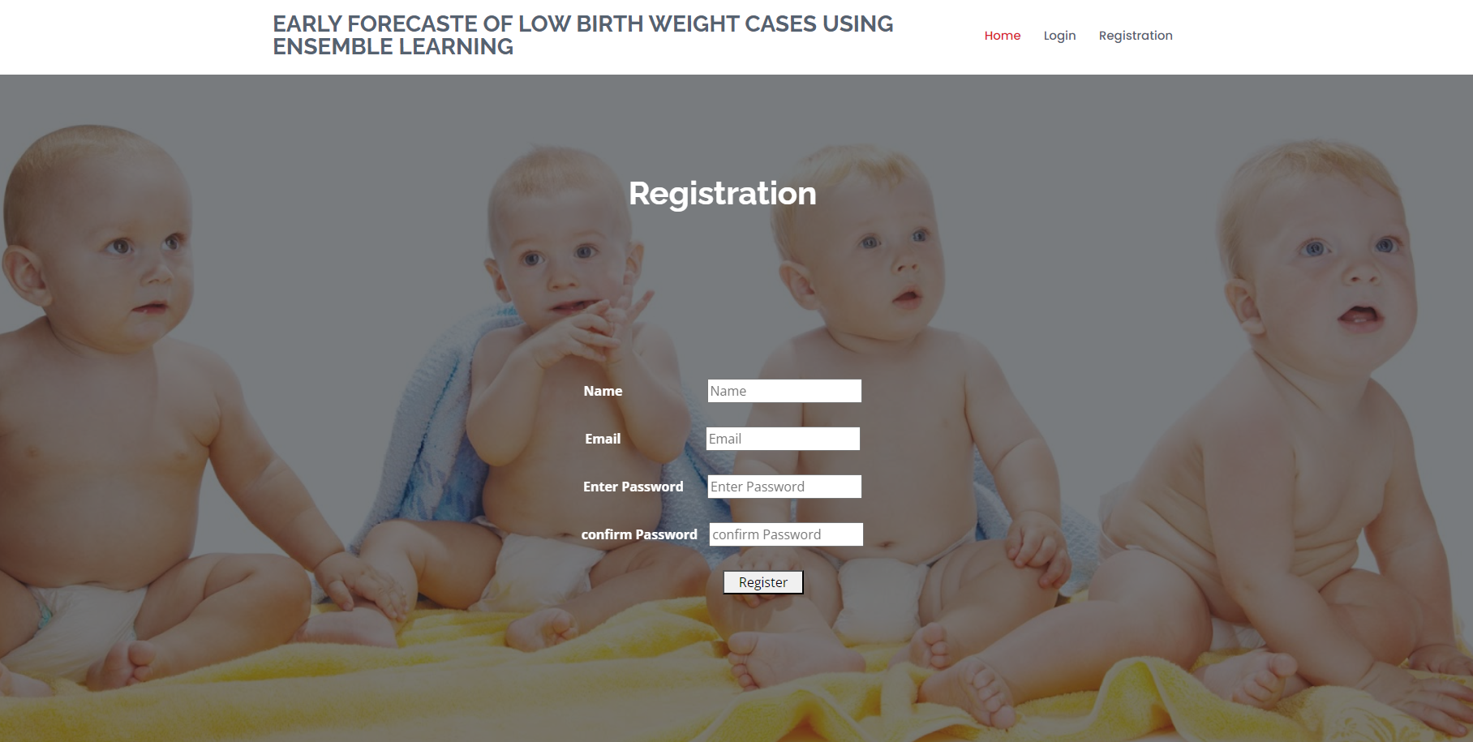
Results
Registration Page:

Slide 35
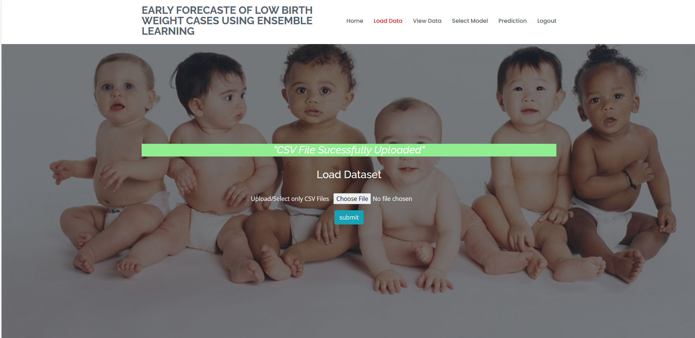
Results

Slide 36
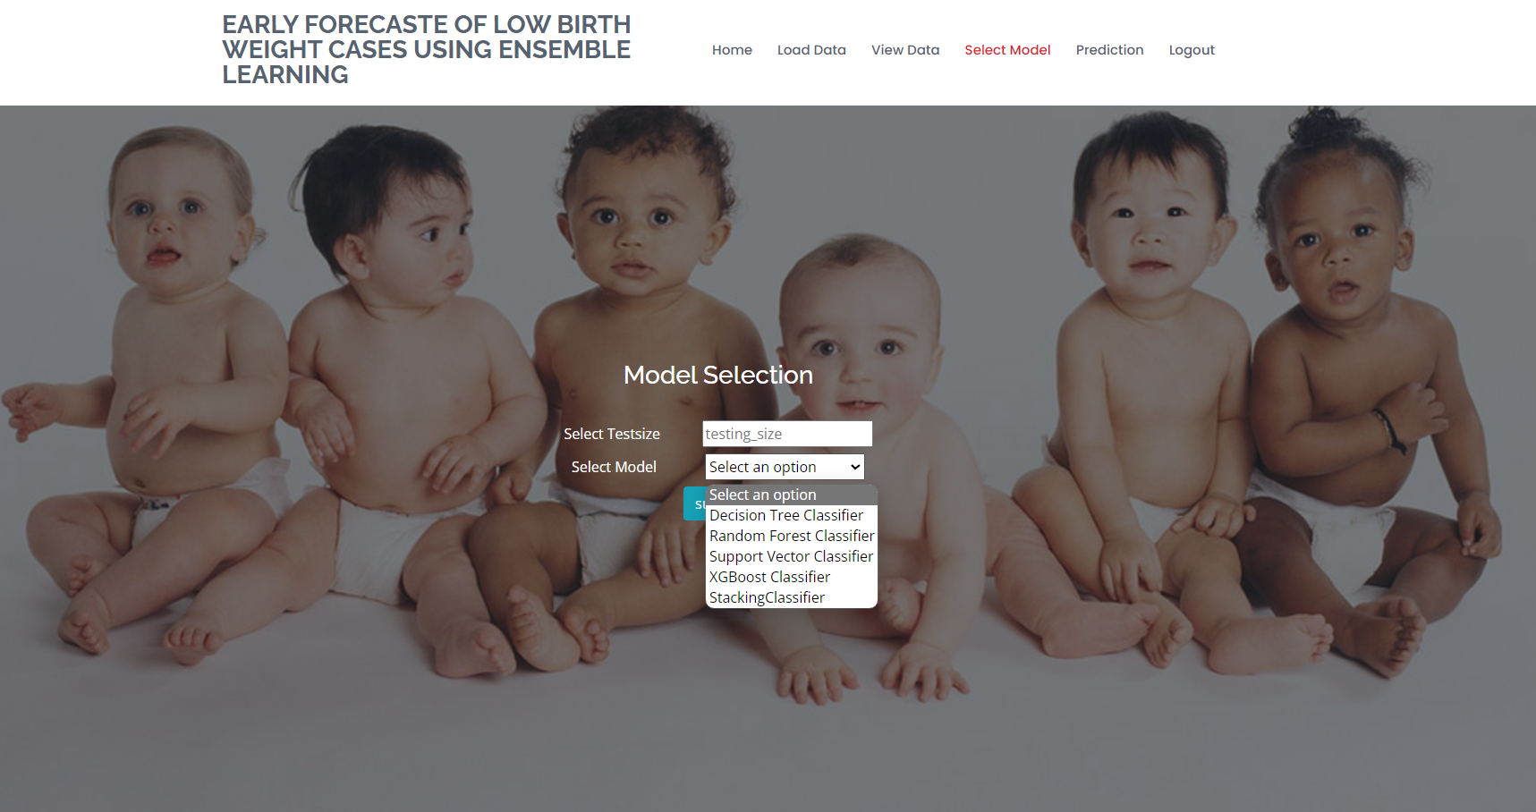
Results
Model selection:

Slide 37
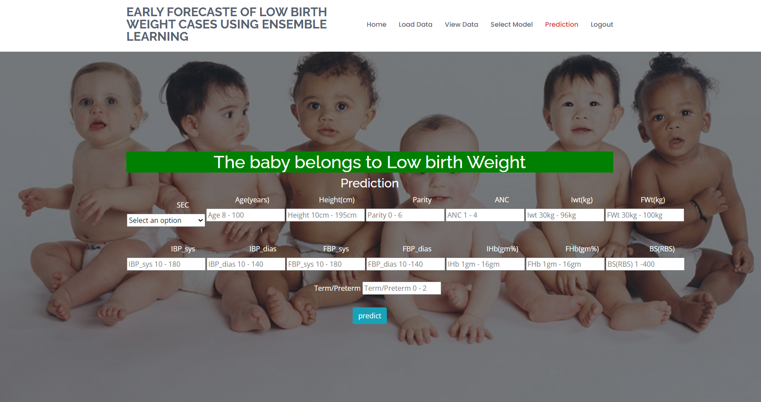
Implementation
Output Result1:

Slide 38
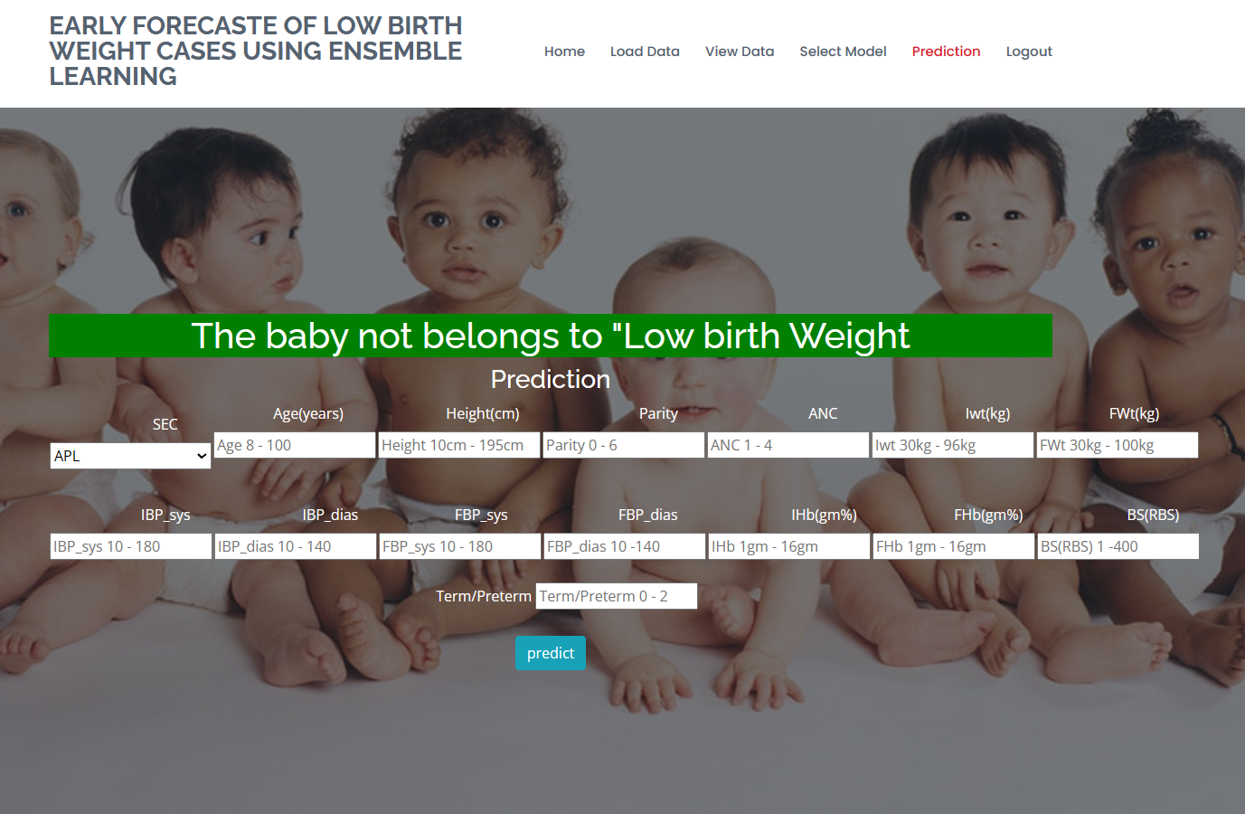
Results
Output Result2:

Slide 39
Research Paper
Research Paper

Slide 40
Conclusion
In this application, we have successfully created a ML model to evaluate whether the unborn child falls inside the Low-Birth-Weight category or not. This is developed in a user-friendly environment using Flask via Python programming. We noticed that out of XGBoost Algorithm, Random Forest, Decision Tree, Support Vector Classifier and stacking classifier stacking performs well with better accuracy.
In our application developed with Python, we have implemented ML models to accurately determine whether a baby is at risk for Low Birth Weight. Through thorough evaluation, we observed that the XGBoost Classifier, Decision Tree Classifier, Support Vector Classifier, with the innovative Stacking Classifier consistently outperformed other models, showcasing their robust accuracy and effectiveness in predicting Low Birth Weight cases. This comprehensive model ensemble ensures reliable and precise predictions for enhanced decision-making in healthcare scenarios.

Slide 41
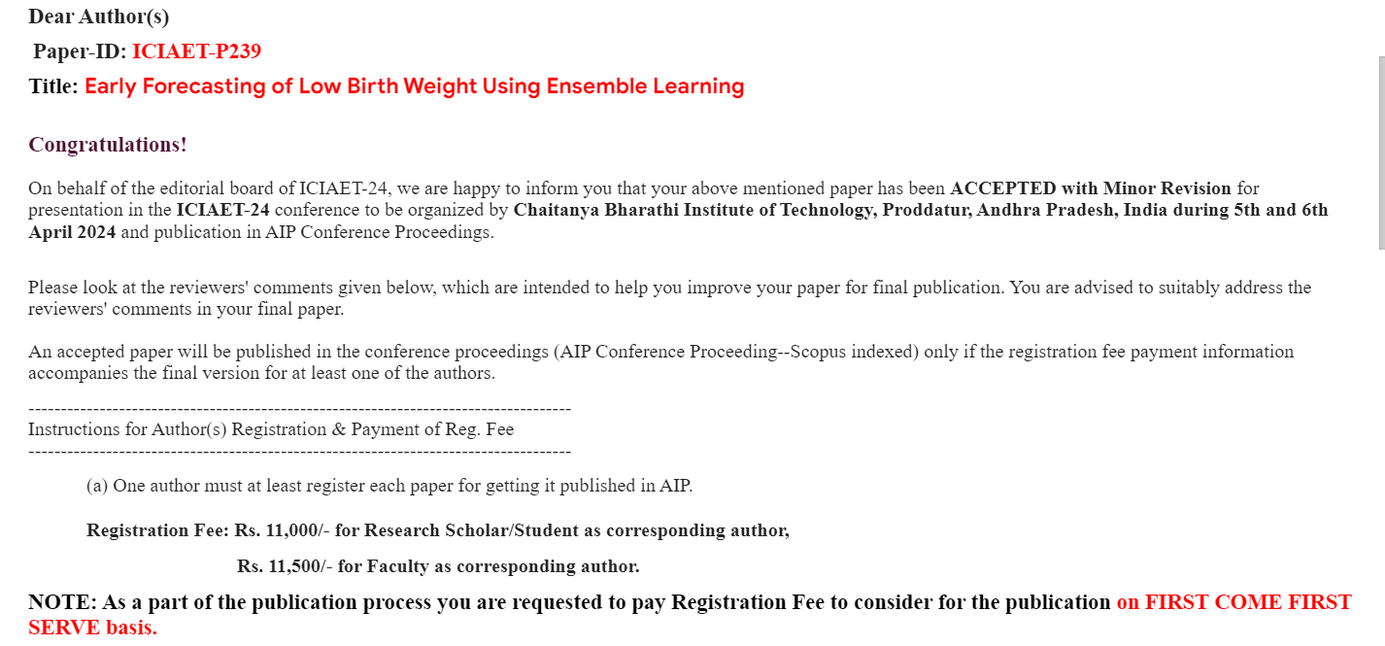
Acknowledgement

Slide 42

Acknowledgement

Slide 43
References
Vega J, Sáez G, Smith M, Agurto M, Morris NM. Factores de riesgo para bajo peso al nacer y retardo de crecimiento intrauterino en Santiago de Chile [Risk factors for low birth weight and intrauterine growth retardation in Santiago, Chile]. Rev Med Chil. 1993 Oct; 121(10):1210-9. Spanish. PMID: 8191127.
Kramer MS. Determinants of low birth weight: methodological assessment and meta-analysis. Bull World Health Organ. 1987; 65(5):663-737. PMID: 3322602; PMCID: PMC2491072.Dharmik, R. C., Chavhan, S., Gotarkar, S., y Pasoriya, A. (2022)
Theodoros Evgeniou,Massimiliano, Support Vector Machines: Theory and Applications, September 2001, DOI: 10.10.1007/3-540-44673-7_12 .
Yash Khandelwal, “Ensemble Stacking for Machine Learning and Deep Learning”, 13 Aug, 2021.

Slide 44
Thank You!!!

